Slide 1
Breakfast of Champions
CPCU Champions - MN Chapter
May 12, 2010
Mendakota Country Club
Notes:
We’d like to thank you for joining us for breakfast, and for taking time out of your busy schedules to visit with us this morning.
My name is Royanna Carle, and I’m the incoming President of the MN CPCU Chapter.

Slide 2

Notes:
We’ve invited you here this morning to talk about the MN CPCU Chapter, get your thoughts/feedback– especially as we head into the Chapter’s planning meeting next week for Chapter year 2010-2011.
We all share a sense of pride being a CPCU – and being a part of the CPCU Society. The MN Chapter is a great chapter – recognized annually by National, in particular, for the educational value it provides to its members and the local insurance community. The MN Chapter has over 500 members...and is led by a team of volunteers who serve as its Chapter officers, on its Board, or as a Chapter volunteer on one of the many standing Chapter committees.
We do a lot of great things – but we want to do better – we want to do more – and more importantly, we want to make sure that what we’re doing is what you (the members and your organizations) want and expect us to do.
Through this Champions network, you provide the Chapter with an important pulse on what’s important within organizations today, so we can help you address and meet your important organizational needs, goals and objectives.

Slide 3
Today’s Agenda Topics
New Designees
CPCU Candidates
Social Networking / Social Media
Dues / Program Fees
Ideas from the National Leadership Institute/Chapter Leader Workshops

Slide 4
New Designees
809 New Designees to date
1250 expected for the 2010 class in Orlando, FL
CPCU Membership included – 1st year
Notes:
New designees receive membership in the CPCU Society for the first year (calendar year – not year from completion) – so encourage and personally invite to attend CPCU events.

Slide 5
CPCU Candidates
President’s CPCU Scholarships – promote within your organization
Individual Encouragement and Mentoring
Candidate Outreach Contest
CPCU class – interest?
Notes:
The President’s CPCU Scholarship program offers 100 scholarships for completing the CPCU designation program. The scholarship covers the cost of CPCU textbooks, course guides, SMART study aids and national exams (an estimated value of $3,800 per scholarship). Hand out the brochures. Be sure to promote this scholarship within your organizations.
Individual encouragement, early and often intervention, and mentoring is huge with CPCU candidates. Only 17% of people who start CPCU finish the designation. The designation definitely wouldn’t mean as much if it weren’t so challenging to achieve. Still 17%! We have to find a way to increase that %. You’ve probably heard before that 66% of CPCU completers do not pass at least one exam. Today, however, it is much easier to re-test…with the more frequent testing windows, versus waiting 6 months to take again.
The Institutes are sponsoring a contest for its CPCU Society Chapters – the Candidate Outreach Contest…which is designed to encourage interaction among CPCU Chapters and people pursuing the CPCU designation. The more contact CPCU students have with their local chapters, the more likely they are to complete the CPCU program and ultimately become CPCU Society members. We need your help! National has provided us with a list of candidates by company who have completed at least one course. We’ll be encouraging current and prospective CPCU students to attend one or more chapter activities between now and August 15th…and will be asking you to encourage those candidates within your organization.
Is there interest in a CPCU class? The Chapter is seriously considering putting on a class this fall. The Insurance Women’s group (many of you know Maureen Georgou) is interested in partnering with the Chapter on this. We think we have a speaker lined up and a location – most likely along the Bloomington strip (Western National).

Slide 6
Social Networking/Social Media
Workforce Demographics and Attrition
Individual Usage
Your Company Usage
Linked In
Others: Facebook, Twitter
Linked In Group – “CPCU Society Champions”
Notes:
Of the four generations in today’s workforce (across all industries), 5% are traditionalists, 45% Baby Boomers (born between 1946 and 1964), 40% Generation Xers (born between 1961 and 1981), and 10% Millenials, In the insurance industry traditionalists and boomers make up close to 60% of the workforce. There is a big concerns in our industry about attrition and obsolescence. Refer to the Business Insurance article on workforce demographics.
We have to find a way to reach younger professionals in our industry and get them involved.
Individually – how are you using social networking? Does your Company use social networking? How is your company using this medium? Which sites? Thoughts?
For those of you on Linked In – we encourage you to join the group CPCU Society Champions. There are over 900 Champions nation-wide….a great group to tap into and with whom to network.
Social networking idea from the NLI – like speed dating, done with CPCU and RIMS chapters.

Slide 7
Dues / Program Fees
National and MN CPCU dues
Program fees
Changes?
Notes:
For a few years now, the Chapter has been discussing how best to structure its Chapter fees. And, based on conversations with other Chapter leaders a couple of weeks back at the NLI, other Chapters struggle with this as well. The Chapter is contemplating increasing the MN dues, and with the increase, reduce the cost for attending monthly programs. How would an increase in fees go over if it covered monthly meetings – all meetings except Institute CE classes and All Industry Day?
Share ideas on what other chapters are doing across the country.

Slide 8
NLI/Chapter Leader Workshops
Ideas from other CPCU Chapters across the country
Chapter Challenges
Educational Topics – ideas for 2010-2011
Champions Open House – Annual Meeting – Orlando, FL
Notes:
Go over notes with ideas picked up at NLI/Chapter Leader workshops.
The challenges we, as a Chapter, face are shared by most Chapters across the country…increasing attendance at meetings, increasing Chapter membership, increasing corporate support and sponsorships, increasing participation from colleges/universities, including internships and mentorships, getting “younger” people involved CPCU and after conferment, becoming active in the Society, focusing on the perception and value of the CPCU designation and so forth.
Ideas for educational topics in the coming year. What would y’all like to see? James Ketterson with Hartford (a CPCU Champion – is he here today) recommended the Change Masters/Learning to Lead speaker series which focuses on core leadership skills. Are others familiar with this program?
The Boston Chapter does a boiler & machinery presentation, followed by a tour of a brewery, and concludes the event with a networking social. The SC Chapter along with the localRIMS Chapter did a tour of the BMW plant this past year – the Milwaukee Chapter toured the Brewers ballpark.
We’ve talked about social networking, what would you think of the Chapter holding a monthly meeting on how to “use” social networking within your organization…and personally as well?
At this year’s annual meeting in Orlando, on September 26 and 27, there will be a Champion Open House. I encourage you to stop by, if you plan to attend the national conference this year. Provide the hours…

Slide 9
The Role of a Champion
A CPCU Champion helps the Society meets its strategic goal of having CPCU become the most widely recognized, valued, and highly respected professional designation in the property and casualty insurance industry.
Be sure to let HR and your Training Departments know you are the CPCU Champion at your Company!
Notes:
Make sure your organization’s training and HR people know that you are the contact within your organization for questions regarding CPCU. Also, you need to be looped in when someone within your organizations starts down the CPCU path.

Slide 10
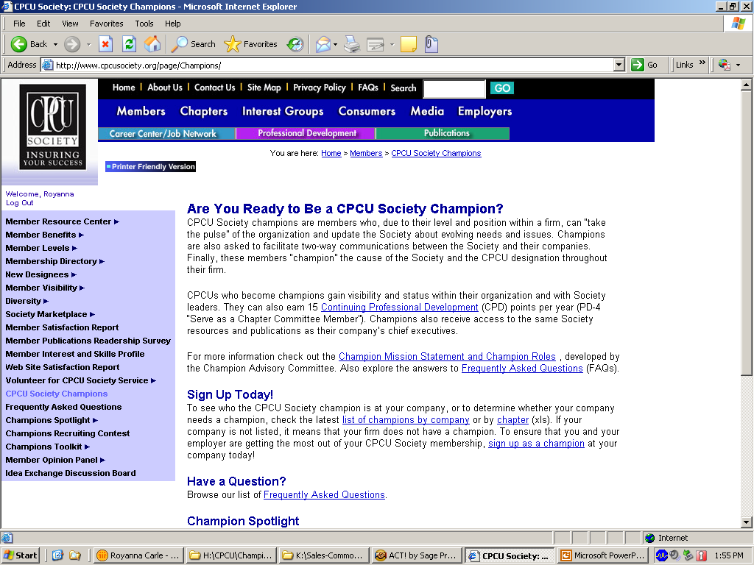
Notes:
If you log onto the CPCU Society website – you can find tools and resources for your role as a CPCU Champion. It is under the Members tab – titled CPCU Society Champion.

Slide 11
Champion Mission Statement
“As a CPCU Champion, I am an active advocate of the CPCU experience to all with whom I come in contact, whether a business, a possible CPCU candidate, a fellow CPCU or simply the community in which I live. I am an active liaison between the CPCU Society (including its chapters), the AICPCU/IIA, my employer and the professional property-casualty insurance community.”
Notes:
Please refer to the inside cover of the booklet

Slide 12
Chapter Contacts
Royanna G. Carle, President, rcarle@berkleyrisk.com
Mike Happe, Immediate Past President,
mike.happe@sfmic.com
Gary Pasterik, Vice President, gary.pasterik@wnins.com
Paul G. Zerby, Board Member, paul.zerby@aonbenfield.com
Notes:
For questions about your CPCU Chapter or regarding your role as a CPCU Champion, please feel free to contact any of the following Chapter Board or Officer Members…
We look forward to hearing from you and welcome your thoughts, input and ideas – anytime. Please….

Slide 13
Notes:
THANK YOU – thank you for your time this morning. We really appreciate your time, interest and participation today. Its active and supportive members like you that make the MN Chapter such a great Chapter…you make us all look good!

